Slide 1
Introduction
23.10.25
Introduction to Data Science and Machine Learning

Slide 2
Introduction
Organizational information
Course structure
What is Data Science?
Tools for programming

Slide 3
Personal Introduction
Notes:
Write in the Chat where you are located

Slide 4

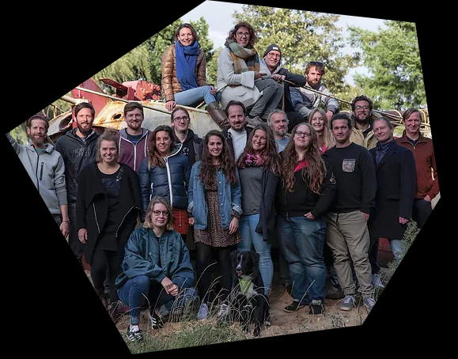
Nonprofit organization which oversees a variety of initiatives
Offering a wide range of educational opportunities, support, and networking for entrepreneurs, creatives, and anyone curious, regardless of age, educational background, or origin
The services are open to everyone and mostly free.
The goal is to support the entrepreneurial landscape, promote creative change processes, and contribute to innovative and sustainable future development.

Slide 5
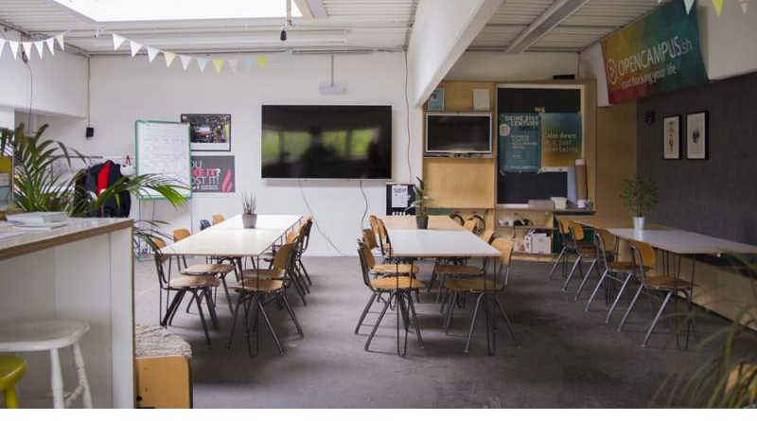




Slide 6




Slide 7





Slide 8
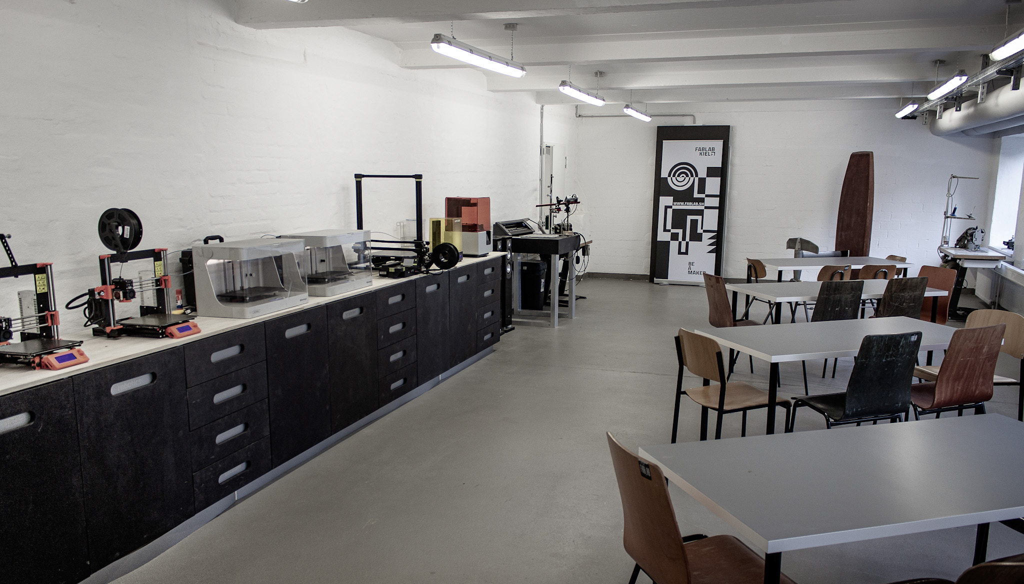





Slide 9



Slide 10
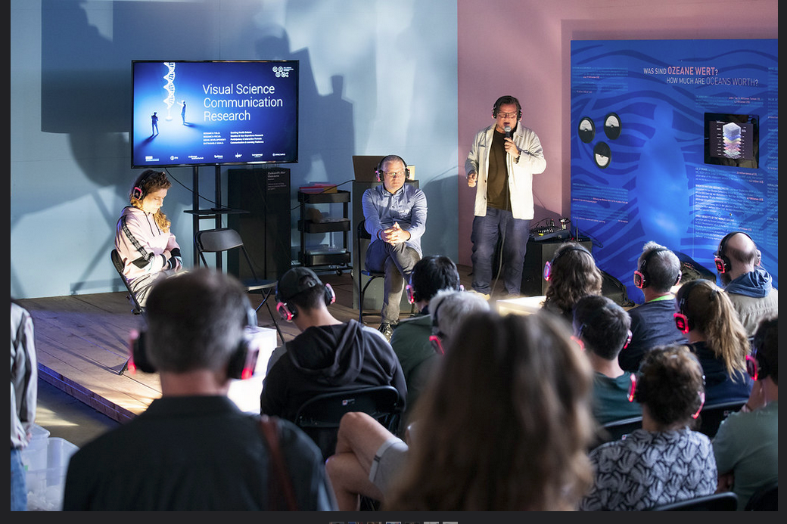
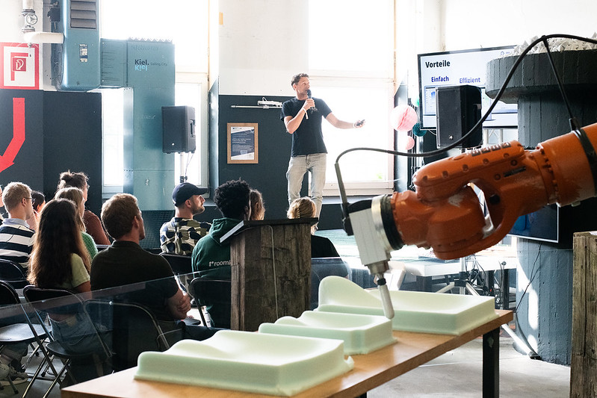



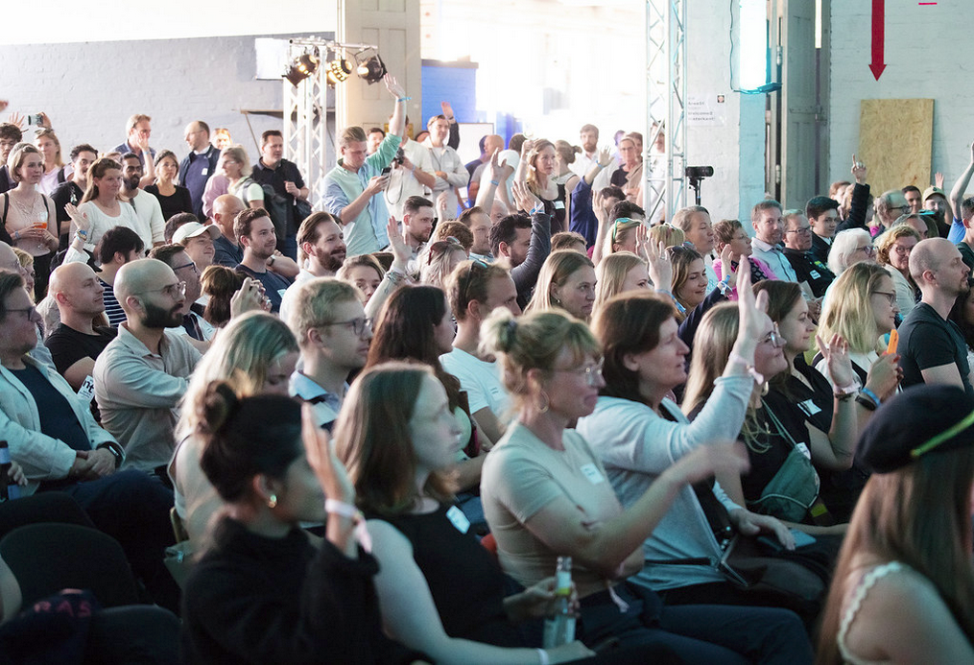

June 19-20

Slide 11
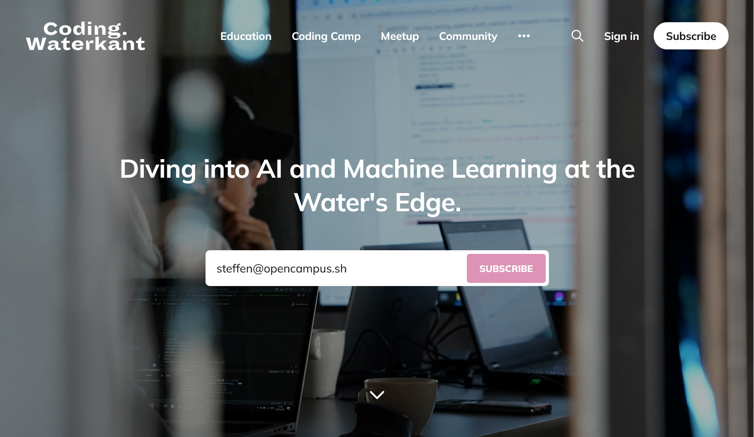
https://coding.waterkant.sh

Slide 12
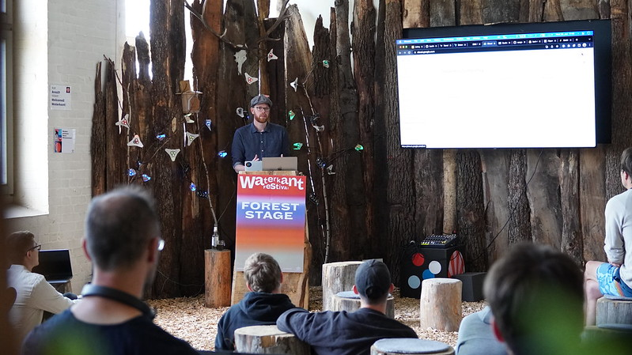

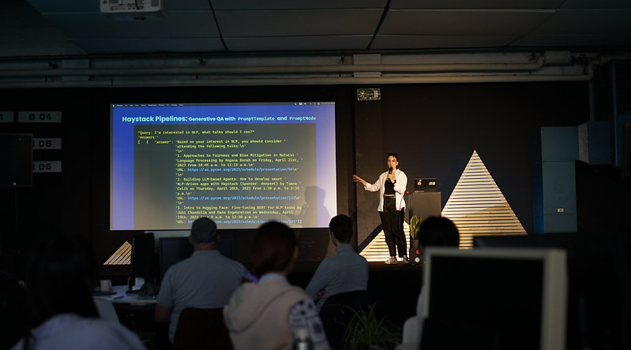

Coding. Waterkant
2026

Slide 13
Coding.Waterkant 2026
July 06 - 10
Work for four consecutive days:
on your own machine learning project or
support others in their project
Take part in workshops
Get input and feedback by invited experts
Present your work to a larger audience.
Take educational leave
Get accommodation on site

Slide 14
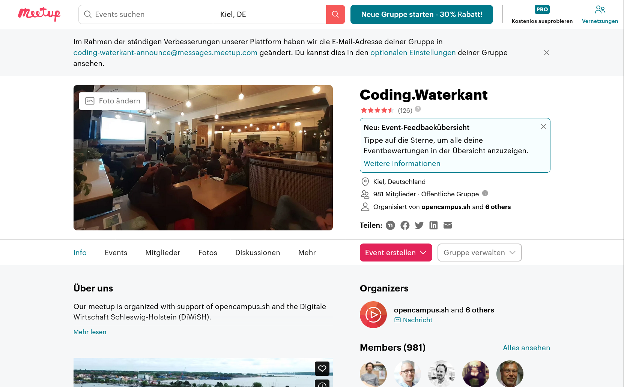

Slide 15
Organizational Matters
Attendance Registration:
Online
Use your full names in the zoom meetings!
Turn your camera on!
Take part via laptop or desktop in a sufficiently quite environment!
Presence
Scan the QR-Code if you participate in presence
Please write us if you will not go on with the course!

Slide 16
Mattermost Chat
Complete your profile in the Mattermost chat with your full name and a photo.
Please, do not write personal messages to the instructors! Always ask your questions in the course chat!!

Slide 17
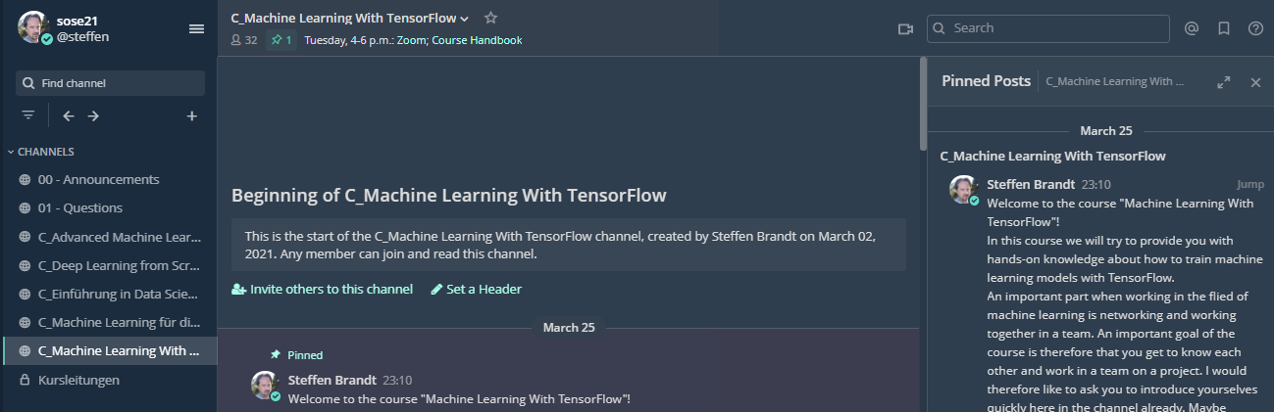
Mattermost Chat

Slide 18
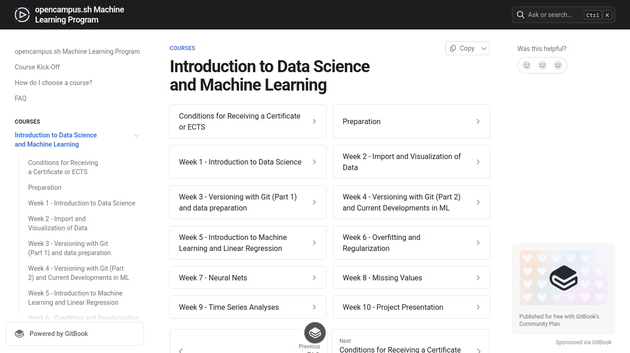
Course Handbook

Slide 19
Zoom
Try the different viewing modes:
Gallery View/ Active Speaker
Split Screen/ Full Screen Mode
Maybe watch this video to get an idea:
https://www.youtube.com/watch?v=v3IPAbpVjd4

Slide 20
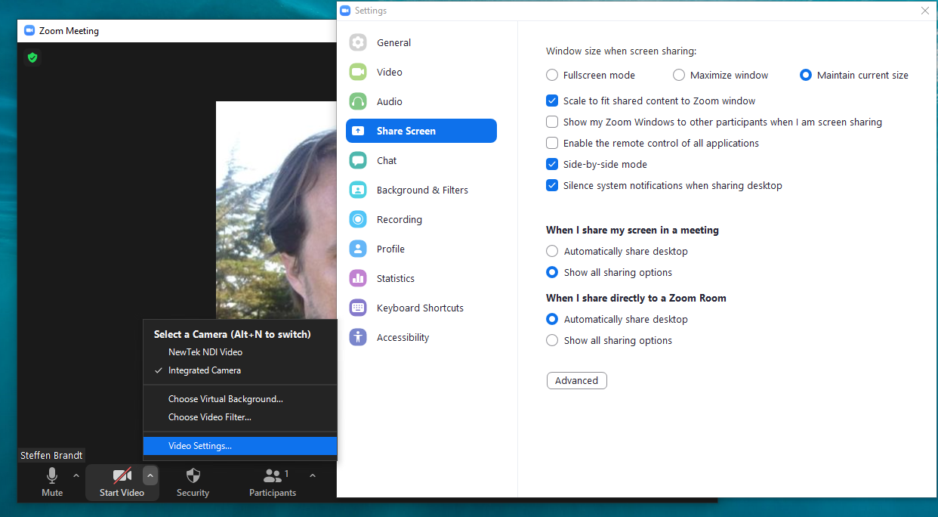

Slide 21
Breakouts
For Online Participants:
Take a screenshot of the task before joining breakouts!

Slide 22
Sales Forecast Project
Real sales data from various product groups of a bakery branch over a period of approximately 3 years
Weather data for the corresponding period (and beyond)

Slide 23
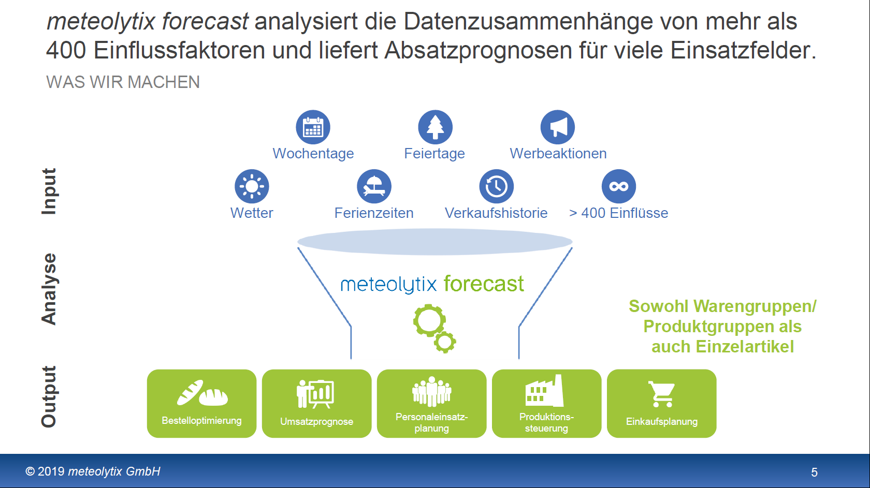

Slide 24
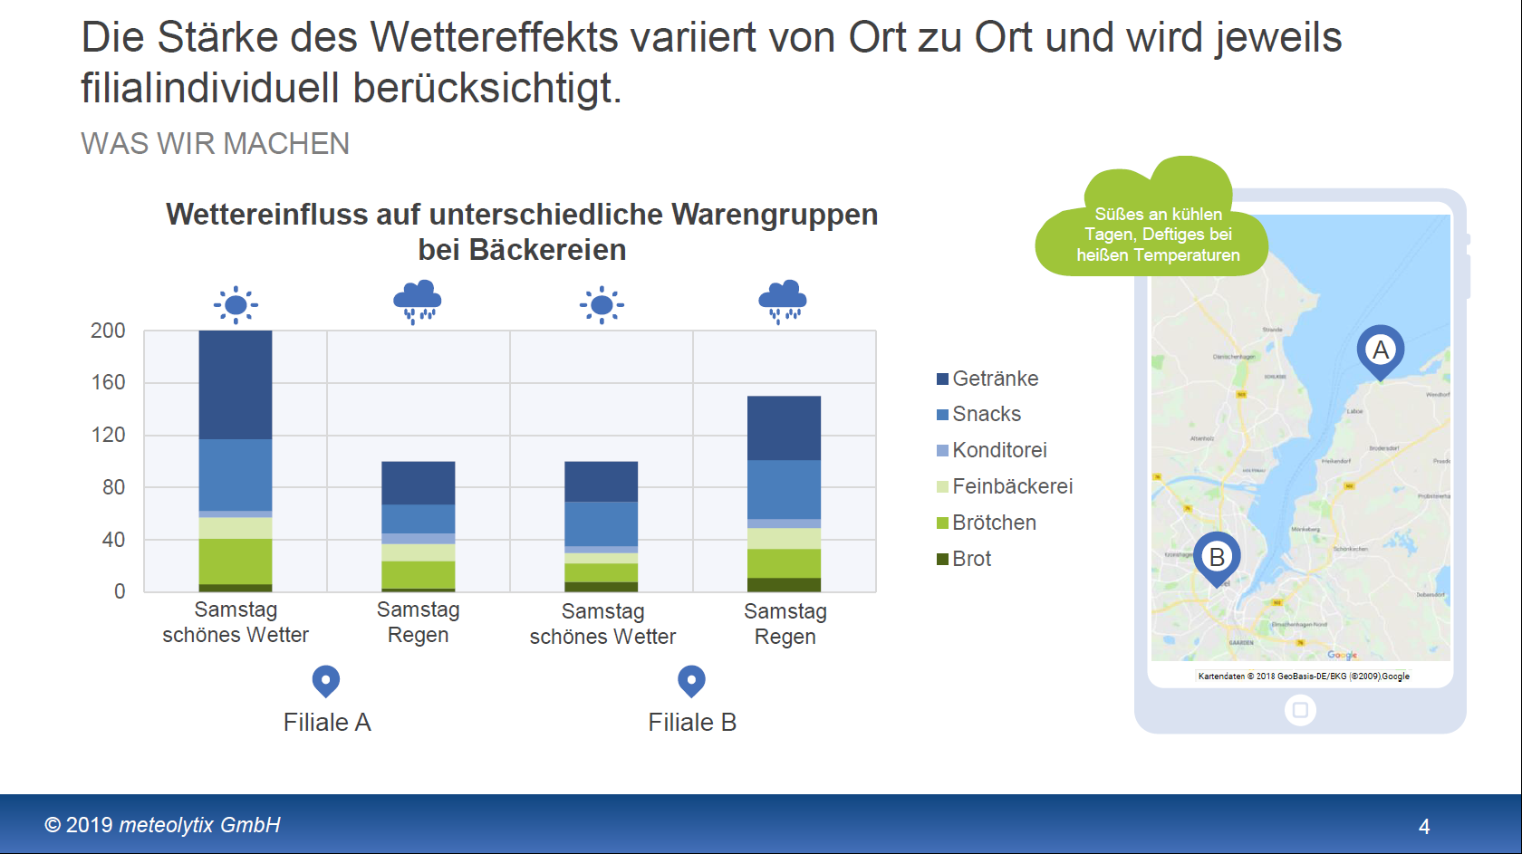

Slide 25
Project Goals
Programming with AI support in VS Code
Working in a team with version control (Git)
Preparation of variables
Use of graphical representations
Use of regressions to identify relevant variables
Handling missing values
Optimization of a neural network

Slide 26
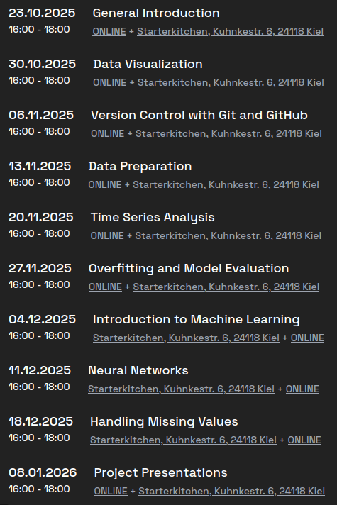
Definition of the Teams

Slide 27
„Education is the only thing that humans try to get less out of than what they pay for.“
Notes:
Stellt Fragen!
Beantwortet Fragen!

Slide 28
First Breakout
15 Minutes
Present yourself
Discussion Question: How is Artificial Intelligence defined?
Try to agree on a definition
Share your definition in the course channel in Mattermost

Slide 29
What is AI?
Chess computer
Google Maps
ChatGPT

Slide 30
“What's the difference between data science, machine learning, and artificial intelligence?”
http://varianceexplained.org/r/ds-ml-ai
Data science produces insights.
Machine learning produces predictions.
Artificial intelligence produces actions.

Slide 31
Data Science
Application of statistical analysis methods to generate results for a report or article.
Descriptive statistics
Statistical inferences
Data visualization
Design of experiments

Slide 32
Machine Learning
Predicting future states
Inferring unobserved states
Estimating current states
The use of statistical optimization techniques to estimate model parameters for a prediction function validated with unseen data.
Typically, model performance is continuously improved by incorporating new data, allowing the system to adapt and refine its predictions over time.
Predicting future states
Inferring unobserved states
Estimating current states

Slide 33
Artificial Intelligence
„an autonomous agent executes or recommends actions“
(Poole, Mackworth, & Goebel, 1998)
„Artificial intelligence (AI) refers to systems that display intelligent behaviour by analysing their environment and taking actions – with some degree of autonomy – to achieve specific goals. “
(European Commission, 2018)
„ By Artificial Intelligence, we understand highly developed software systems that are capable of learning and can be trained to handle complex tasks.“
(AI Strategy of Schleswig-Holstein, 2019)
Notes:
Es gibt keine Definition von KI!

Slide 34
Tools to create and execute Code
Programming language + libraries
Execution environment
Development environment
Programming language + function libraries
Execution environment
Development environment

Slide 35
Programming Language: Python
Open source, huge community → large amounts of existing example code → very good AI support
Industry and (slowly getting) academia standard for data analysis
Primary ML language
Fastest-growing language with wide application range including productive settings
Extensive function libraries for:
Web Applications (z.B. Django und Flask)
Data Analysis (NumPy, Pandas)
Visualizations (Matplotlib, Seaborn)
Neural Networks (TensorFlow, PyTorch)

Slide 36
Python Characteristics
Interpreter language (executes line-by-line)
Console-based (no GUI)
Fastest-growing language
Evolved from software engineering (vs. R from statistics)
Interpreter language (executes line-by-line, similar to a calculator)
Console-based (no GUI)
Evolved from software engineering (vs. R from statistics)
Notes:
Current Ranking of Popularity of https://pypl.github.io/PYPL.html

Slide 37
Execution Environment:
Jupyter Notebook:
Browser-based execution of code via a GUI
Popular in ML and Data Science
Python Script:
Execution of code from a text file
Used particularly in production

Slide 38
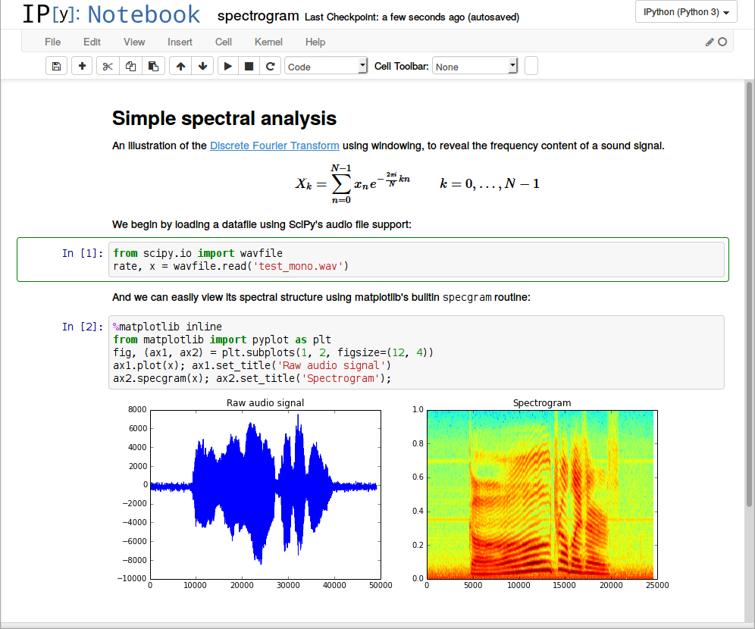

Slide 39
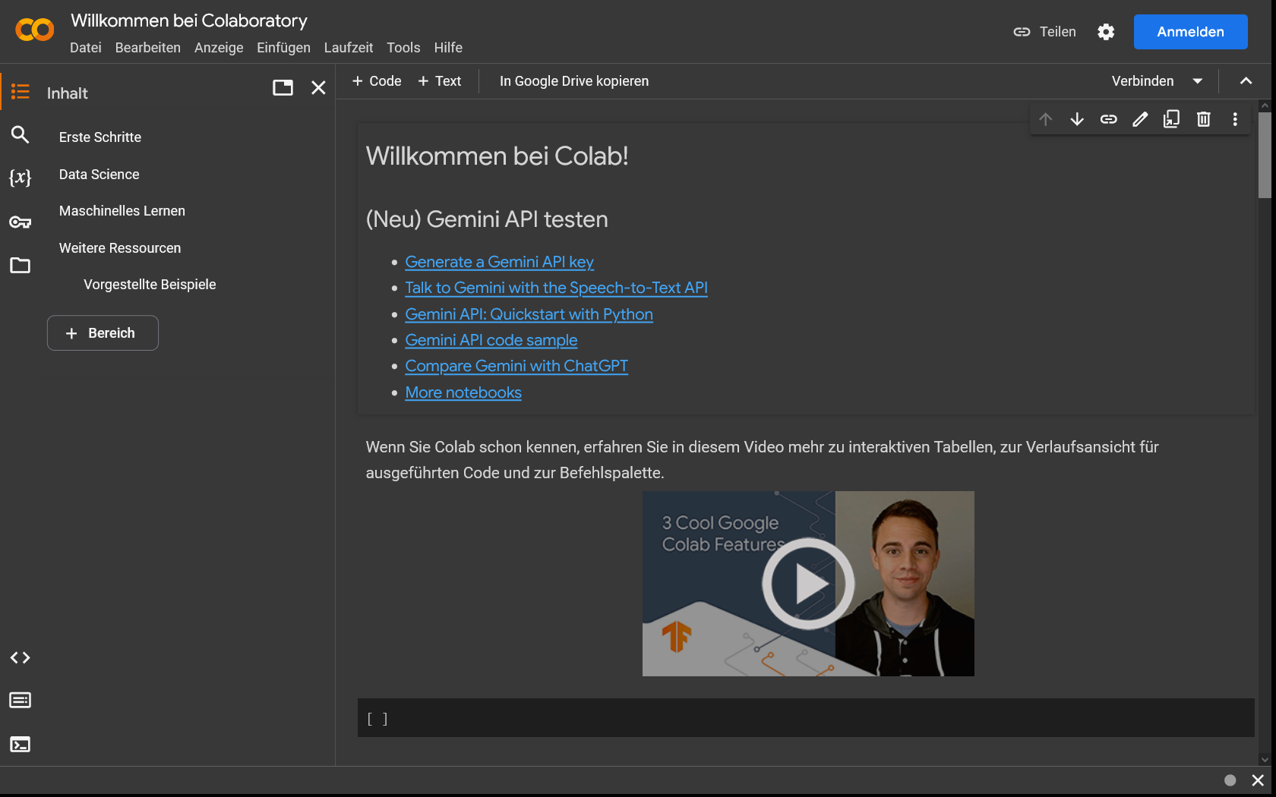
Colab
https://colab.research.google.com/

Slide 40
Characteristics of Jupyter Notebooks
Convenient editing and execution of code in the form of code cells
Display of results directly in the notebook below the executed code cell – including graphical output
Insertion of formatted comments and explanations via Markdown cells
Open Source application, run in a web browser or locally
Convenient editing and execution of code in the form of code cells
Display of results directly in the notebook below the executed code cell – including graphical output
Insertion of formatted comments and explanations via Markdown cells

Slide 41
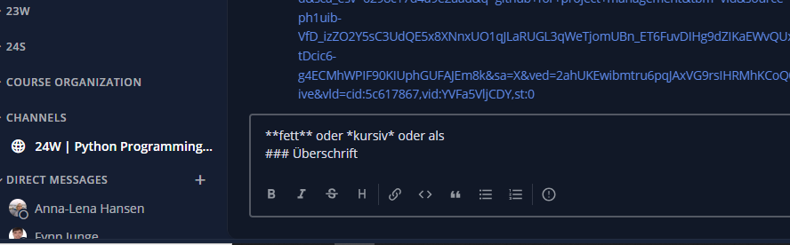
Markdown in Mattermost

Slide 42
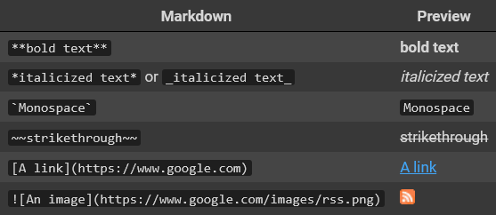
Examples for Markdown Syntax

Slide 43
Development Environment: Visual Studio Code (VS Code)
Open-source programming environment that supports code development
Standard development environment for numerous programming languages in software development
Many extensions and additional features available via plugins
Open-source development environment that supports the creation of programming code
Standard development environment for numerous programming languages in software development
Many extensions and additional features available via plugins

Slide 44
Tools to create and execute code
Software:
Programming Language → Python und Python Packages
Execution Environment → Python Environments or Jupyter Notebooks
Development Environment → VS Code

Slide 45
Tools to create and execute code
Hardware:
Previously, typically only the local computer
Due to increasing computational requirements, code is now often executed in the cloud
Development environments are also increasingly used in the cloud

Slide 46
Our Approach
Local installation of the VS Code development environment
Execution of the code in an environment in the cloud using GitHub Codespaces
Linking the local development environment with the cloud-based execution environment

Slide 47
Why GitHub Codespaces?
No local Python installation required → Avoids potential compatibility and configuration issues across different operating systems
Consistent Execution Environments → Everyone uses the same Python versions and code examples work the same for all
Integration with GitHub and GitHub Copilot → No additional setup required
Live Sharing → Share development environments for real-time collaboration
Automatc Backups

Slide 48
Example Usage
Create a GitHub repository (a cloud-based project workspace)
Add a GitHub Codespace to this repository
Open the Codespace with your local VS Code

Slide 49
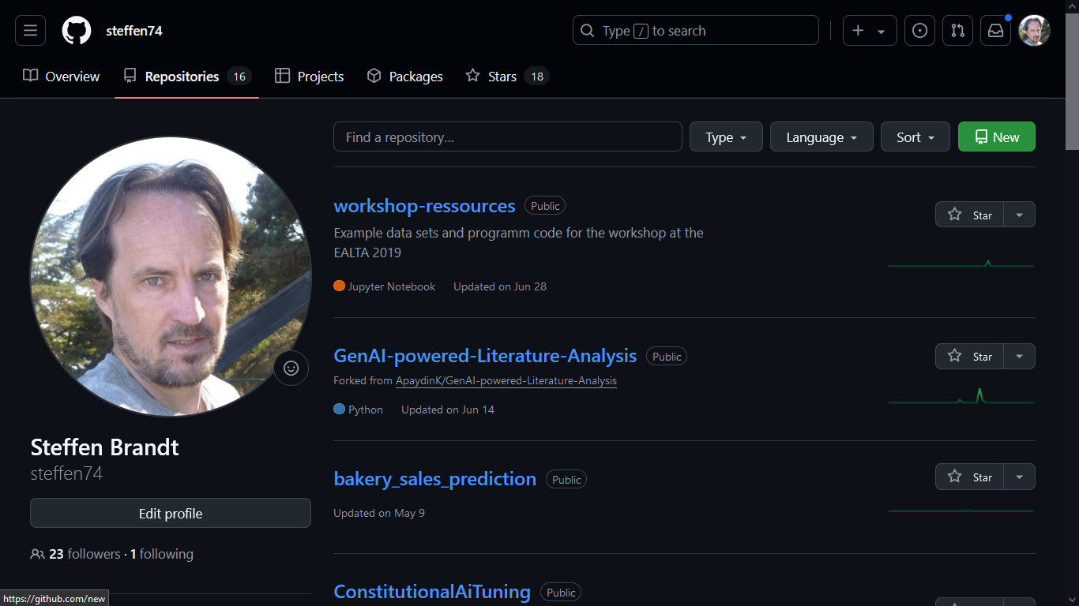
Notes:
https://github.com/opencampus-sh/repo-template-intro-to-data-science-and-ml/

Slide 50
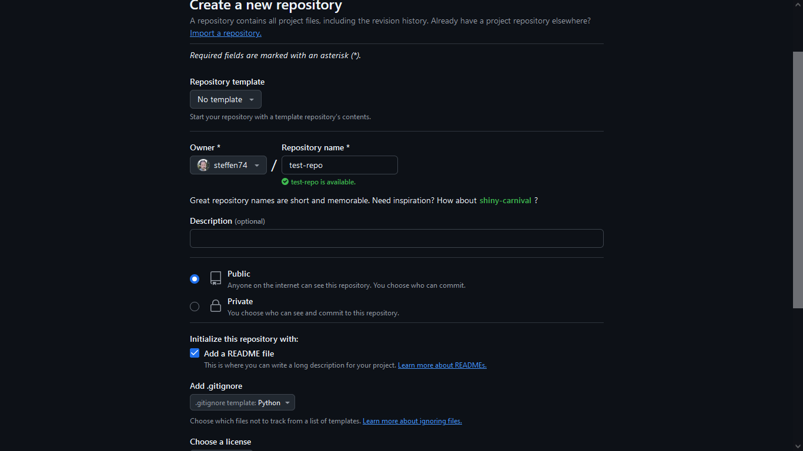

Slide 51
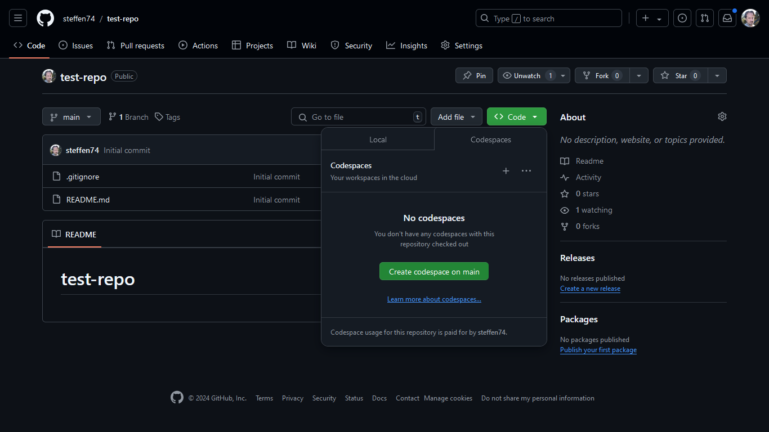

Slide 53
Notes:
https://github.com/opencampus-sh/repo-template-intro-to-data-science-and-ml/

Slide 54
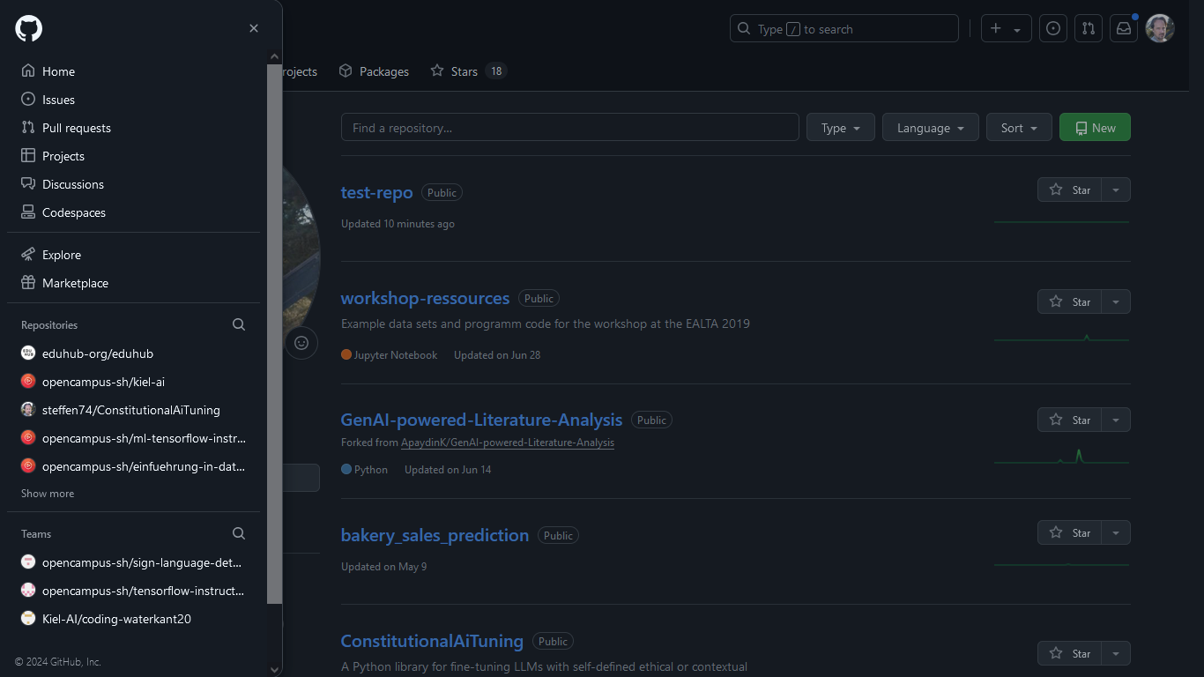
Notes:
https://github.com/opencampus-sh/repo-template-intro-to-data-science-and-ml/

Slide 55
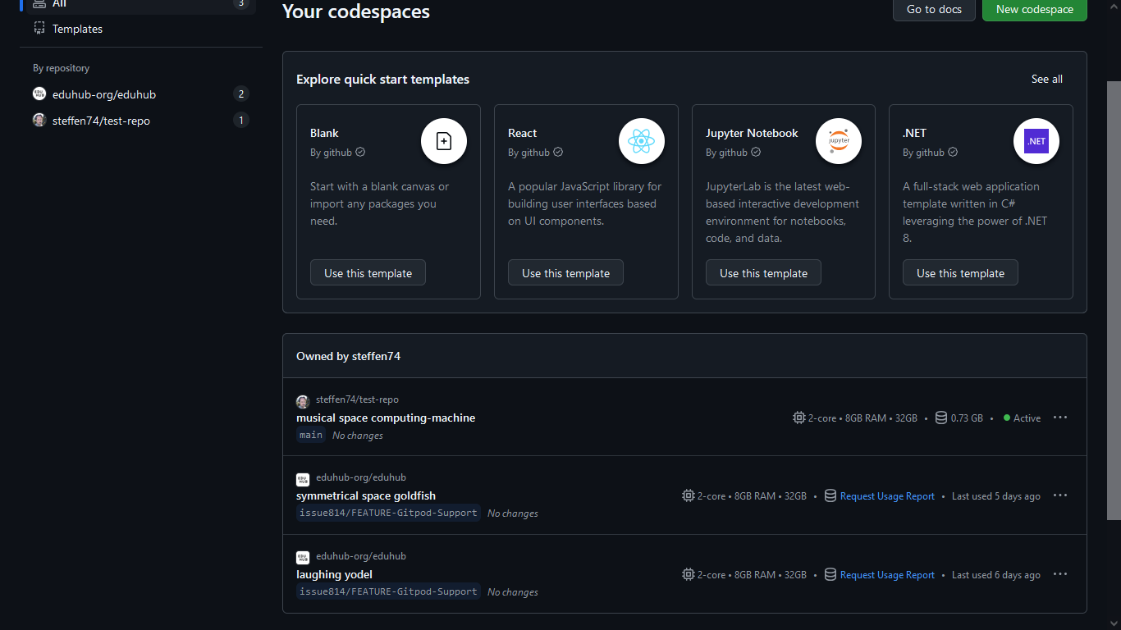

Slide 56
Breakout
Implement different code versions to calculate the mean of the following seven numbers using Python: 1 2 3 4 5 6 9,87654321
Compare them and discuss advantages or disadvantages of the versions.
Notes:
Verschiedene Lösungen in den Mattermost Chat. Copy and Paste in ChatGPT 3.5, Chat GPT 4 und Claude.

Slide 57
Support Tools
Code Completion (GitHub Copilot, Supermaven / Cursor Tab, …)
Specific Code Assistants (GitHub Copilot, Cursor Composer, Qodo Gen, …)
Chatbots (Claude, Gemini, ChatGPT, …)
Google
Stackoverflow
Dokumentation der Funktionen

Slide 58
Learning resources
Watch this video on working with strings (16 minutes)
Watch this snippet on working with numbers (“Numbers” and “Working With Numbers”; 5 minutes)
Watch the first four chapters of this video on functions (12 minutes)
Watch this video on working with lists in Python (18 minutes)
Watch this video on setting up VS Code, specifically for Python and Data Science

Slide 59
Tasks
Import the dataset "umsatzdaten_gekuerzt.csv", which you can download via the following link: https://raw.githubusercontent.com/opencampus-sh/einfuehrung-in-data-science-und-ml/main/wetter.csv
Calculate the overall average temperature.
Calculate the average temperature for the month of July.
Compare whether the months of July and May differ significantly in their average temperature.
Notes:
Die Aufgaben zu Hause durchgehen.
airQuality <- airquality
mean(airQuality$Temp)
july <- airQuality[airQuality$Month==7,]
mean(july$Temp)
may <- airQuality[airQuality$Month==5,]
mean(may$Temp)
t.test(july$Temp, may$Temp)
> airQuality <- airquality
> mean(airQuality$Temp)
[1] 77.88235
> july <- airQuality[airQuality$Month==7,]
> mean(july$Temp)
[1] 83.90323
> may <- airQuality[airQuality$Month==5,]
> mean(may$Temp)
[1] 65.54839
> t.test(july$Temp, may$Temp)
Welch Two Sample t-test
data: july$Temp and may$Temp
t = 12.616, df = 50.552, p-value < 2.2e-16
alternative hypothesis: true difference in means is not equal to 0
95 percent confidence interval:
15.43351 21.27617
sample estimates:
mean of x mean of y
83.90323 65.54839

Slide 60
Registration for GitHub Copilot
Register for GitHub Copilot as described here. As a student or teacher, you get free access to GitHub Copilot Pro following the instructions given here. Alternatively, you can also download and install Cursor, which includes a limited free tier and 10-day pro trial.
Next week, we will go into more detail on possible ways of using AI assistance.

